Slide 1
Histology of Urinary system
Lecture 1 Kidney
Dr. Fatin Latef

Slide 2
Urinary System
Is composed of :
A. Kidney- paired organs that form the urine.
B. Ureters- carry urine to bladder, one from each kidney.
C. Bladder- site where urine is collected and stored until urination.
D. Urethra. Carries urine from bladder to external environment.

Slide 10
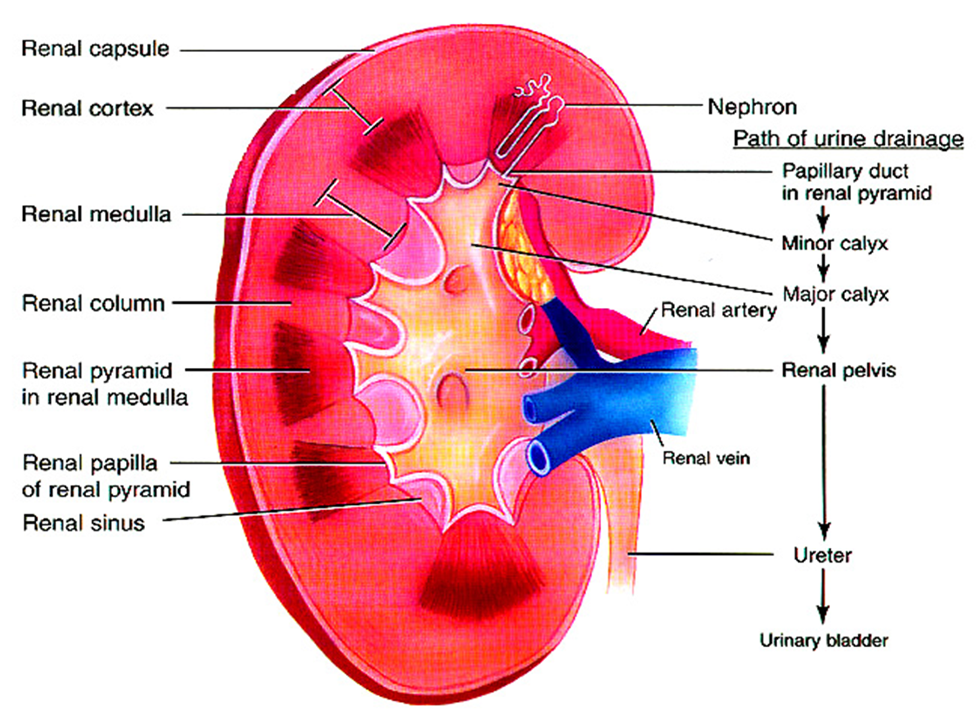

Slide 11
Note-the proximal and distal convoluted tubules are located in the cortex, the straight portion of proximal and distal tubules &the thick, thin segments make a loop that extend in to the medulla called loop of henles.
1-Renal corpuscle :composed of:
A-Glomerulus- a network of blood capillaries (fenestrated) about (10-20) capillaries loop surrounded by Bowman's capsule.
B-Bowmans capsule-enclosed the glomerulus. It has two layers:
*Parietal layer formed by simple squamous epithelium.
*Visceral layer the podocytes.

Slide 12
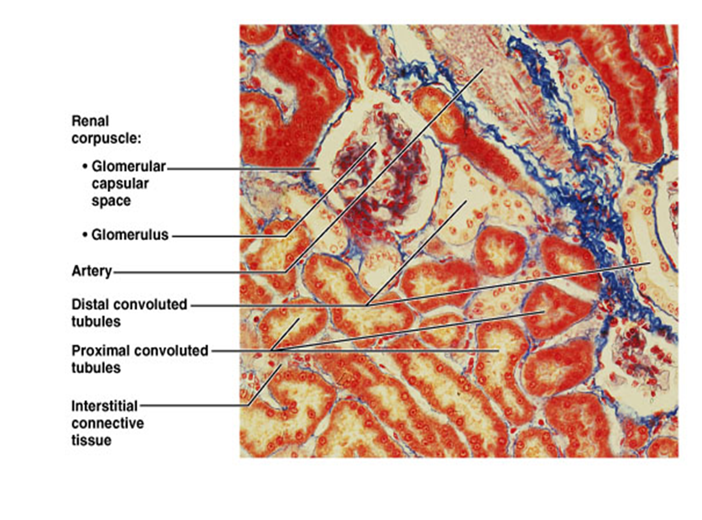

Slide 13
Podocytes
Are modified cells with multiple processes and pedicles.
Their processes and pedicles surround the glomerular capillaries.
The spaces between adjacent pedicles, called the filtration
slits.
The pedicels interdigitate with each other and attach to the basal lamina of capillary endothelium.
Function of podocytes:
Mechanical support; they act to prevent the rupture of the glomerular capillaries due to blood pressure and at the same time allow filtration to proceed.
The secondary processes support the hydrostatic pressure exerted on the basement membrane filtration.

Slide 14
The epithelium covering each capillary is the glomeruli epithelium and that lining the opposing wall is known as capsular epithelium (which received fluid filtered through the capillary wall and visceral layer).
Bowman's space is the space between capillaries and capsular.
Each renal corpuscle has:
-Vascular pole represent the region of the renal corpuscle where the efferent and afferent arterioles are located for composed of glomerulus.
-Urinary pole opposite the vascular pole located where the capsular epithelium is continues with the cuboidal epithelium of the proximal convoluted tubule (PCT begin).

Slide 15
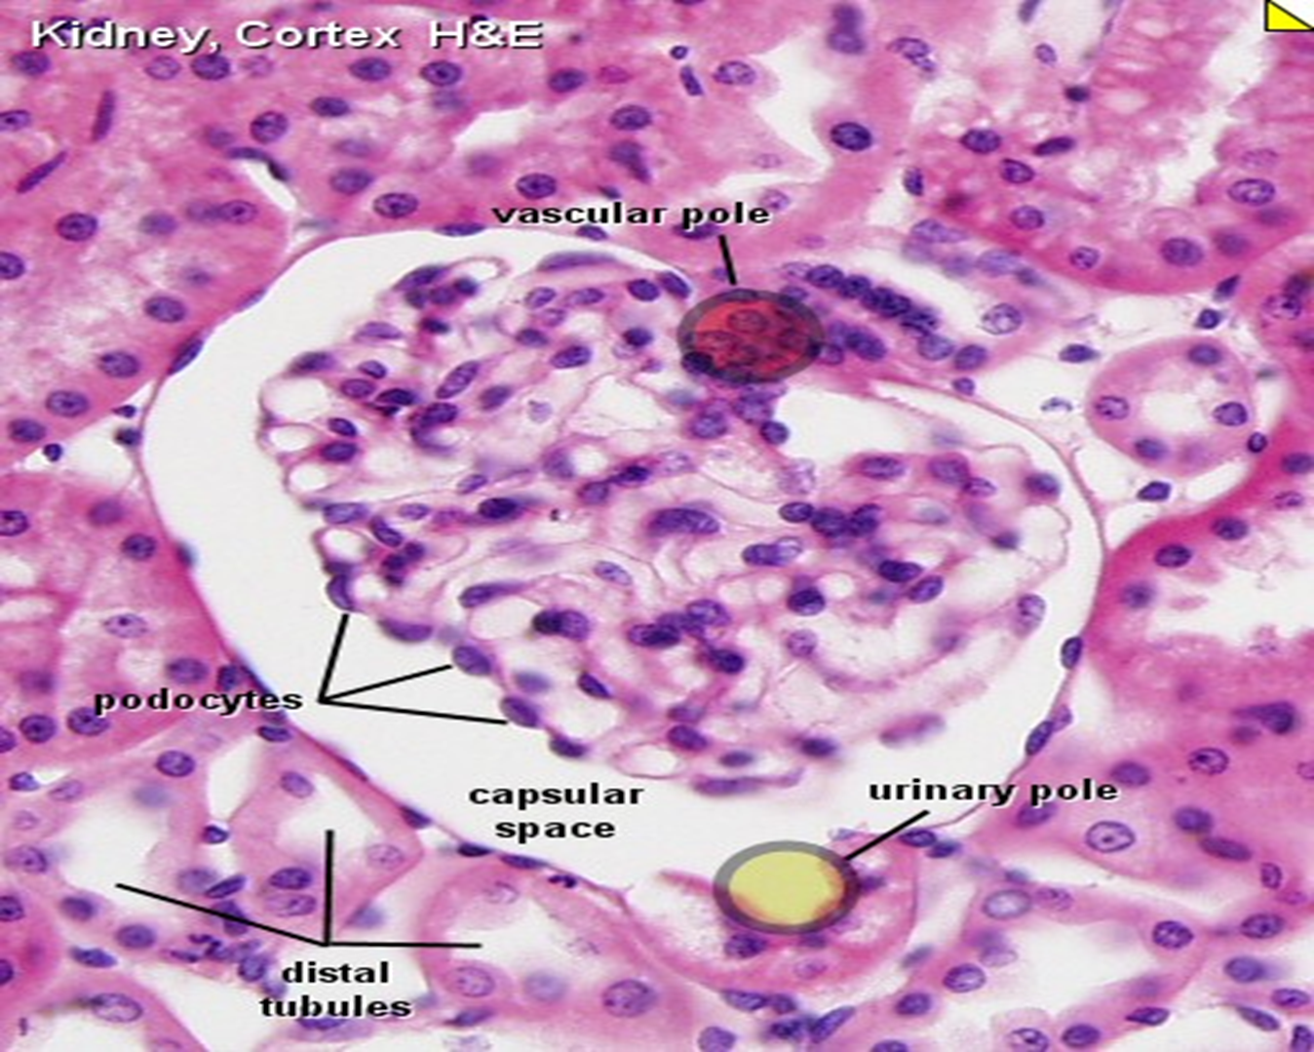

Slide 16
The glomerular capillaries are situated between two arterioles (afferent &efferent) , however, blood through the capillaries it is under considerable pressure and a clear fluid, the blood ultra filtrate, filter through the glomerular vessels walls and the glomerular epithelium in to capsular space, urine is formed from the blood ultra filtrate as flow through the various nephron segments.
Capsular epithelium is typical simple squamous epithelium, it become cuboidal at the urinary pole.

Slide 17
2-Proximal tubules:
Has tow segments:
Convoluted part, which makes several loops in the cortex near the renal corpuscles.
Straight portion, extending in to the outer zone of the medulla.
Histological features:
are lined by high cuboidal epithelium cells that have rounded nucleus centrally located.
The apical surface there is microvilli (brush border) required for reabsorption.
.

Slide 18
more acidophilic than those other parts of nephron, the cytoplasm appears striated due to elongated mitochondria
The lateral surface of cells contains folds 9 they are flattened processes, joined with processes of adjacent cells. these epithelial cells are adapted for fluid and ion exchange.

Slide 19
3-Distal convoluted tubules:
The last part of nephron, are found in cortex.
They are lined by low cuboidal epithelial cells.
There is no brush border, but occasionally one long cilium project in to the lumen.
Have large lumen because the epithelium is lower and the cells narrow there are more nuclei than in cross section of proximal segment.
Less acidophilic than p.c.t, the cells are adapted for fluid and ion exchange

Slide 20
4-Loops of Henle
U shaped structure, composed of thin and thick segments:
Thin segment : consist of descending and ascending limb of henles loop, is lined by simple squamous epithelium about (3-50) cells are seen, they resemble the capillary except, their nuclei protrude more in to the lumen, the surface of cells has a few short microvilli.
Thick segment : consist of ascending limb of H. l, is lined by simple cuboidal epithelium, the cytoplasm is faintly stained, they similar to distal convoluted tubules, the loops maintain the osmotic gradient in renal parenchyma.

Slide 21
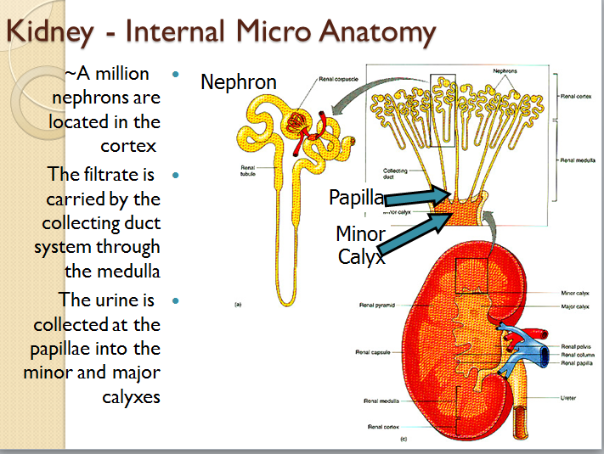

Slide 22
